Slide 1

SD-WAN is an orchestration game
Ericsson SD-WAN orchestration
Speaker name
Organization
YYYY-MM-DD
Notes:
SD-WAN is an orchestration game
Slide responsible: Ana Freitas Best Before: April 2020

Slide 2
Enterprises in the digital transformation era
“Organizations with digital-ready networks are realizing two to three times the revenue growth of organizations without such networks.” - IDC
Superior customer experience
New customers’ buying journeys
Moving services to cloud
Network transformation towards 5G
SD-WAN – programmable, flexible and reliable connectivity
Notes:
Enterprises in the digital transformation era
Slide responsible: Ana Freitas Best Before: April 2020
Superior customer experience: essential to retain existing business and win new customers.
New customers’ buying journeys: driving companies' digital transformation.
Network transformation: needed to achieve a better quality of experience.
“Organizations with digital-ready networks are realizing two to three times the revenue growth of organizations without such networks” - IDC

Slide 3
Transformation has begun – what enterprises seek
Agility to easily scale
at low cost
Decentralized workforces adapting
to more flexible
environments
Secure services
along with optimal application/network performance and
user experience
Visible performance and voice usage,
data and video traffic via unique customer web portals
Large
enterprises
“Between 30 percent and 50 percent of large enterprises have begun adopting SD-WAN.” – Global Data
Notes:
Transformation has begun – what enterprises seek
Slide responsible: Ana Freitas Best Before: April 2020
Industries: adaptable to a variety of devices and applications for onsite/remote/mobile workers and partner sites
“Between 30% and 50% of large enterprises have begun adopting SD-WAN” – Global Data

Slide 4

What is SD-WAN?
Software-Defined networking in Wide Area Networks (SD-WAN) is the answer to the limitations of Wide Area Networks (WAN) in the cloud era
SD-WAN expands the connectivity options
by adding mobility and keeps costs low while providing flexibility through cloud-based services in this new enterprise hybrid environment
6/221 09-FGB 101 0800 Uen | B | SD-WAN is an orchestration game | | Commercial in Confidence | Page 4
Notes:
What is SD-WAN?
Slide responsible: Ana Freitas Best Before: April 2020
Uses Software Defined Networking (SDN) and Network Functions Virtualization (NFV) to expand mobile connectivity options, address bandwidth consumption.
SD-WAN is ideal for the new enterprise hybrid environment.

Slide 5
SD-WAN – agility and security in one
Reduce enterprise branch deployment time
Optimized
On-demand
Deploy and
manage services
on-prem or using
cloud-based systems
Leverage hybrid networking with assured quality and security
Secure
Controlled
Central management for all provided services and end-to-end connectivity
Notes:
SD-WAN – agility and security in one
Slide responsible: Ana Freitas Best Before: April 2020

Slide 6
How to start your transformation journey
Do it yourself
Managed SD-WAN
Co-managed SD-WAN
  1
  2
  3
The enterprise is responsible for installing and configuring devices.
SD-WAN services are
self-managed.
This is SD-WAN services in an opex model. Fixed and mobile connections can be combined, and public
cloud services bundled.
A service provider installs, configures and manages
the SD-WAN services.
The enterprise can
customize parts.
Notes:
How to start your transformation journey
Slide responsible: Ana Freitas Best Before: April 2020

Slide 7
The window of opportunity is now – are you ready?
Demand
Supply
CSP channel
Orchestrate
Moving services from on-premise to cloud is quickly raising the SD-WAN adoption rate among enterprises.
60+ established SD-WAN vendors and OTT players are now active.
Trend for enterprises to get managed SD-WAN services from a CSP rather than a Do-It-Yourself (DYI) approach.
CSP’s need to orchestrate and manage multiple SD-WAN vendors and value-added services for enterprises.
Notes:
The window of opportunity is now – are you ready?
Slide responsible: Ana Freitas Best Before: April 2020
SD-WAN adoption rate among enterprises is high to improve agility and reduce costs.
Incumbent service providers protection and expansion of their Enterprise market needs to be based on their legacy business.
Challenger service providers have an opportunity to win enterprise markets by leveraging their mobile infrastructure.
“SD-WAN market will grow at a 30.2% compound annual growth rate between 2017 and 2022” – Gartner

Slide 8
SD-WAN managed services: now the preferred deployment model
Changing mix of SD-WAN delivery/purchase options
SD-WAN is a
multi-vendor business.
Service providers need orchestration to handle complexity and assure end-to-end quality
of service.
Substitution of CSP managed SD-WAN services
Note: this is 1% - market is growing rapidly
And over time we believe that SD-WAN will become not just a revenue source, but a driver of synergistic revenues
Early on, all SD-WAN was targeted to enterprises, and delivered “Over the
Top” (OTT)
In briefings, many CSPs
Reffered to 2017 as a “launch
and establish” year
As CSPs become recognized, we see growth becoming meaningful in 2018–19
Source: Appledore Research
Notes:
SD-WAN managed services: now the preferred deployment model
Slide responsible: Ana Freitas Best Before: April 2020

Slide 9
Service provider offerings for enterprises
Connectivity
Security
Mobility
Multi-cloud
Guaranteed connectivity between branch offices and headquarters
Reliable connectivity enhanced with
security services
Flexibility to add remote and mobile workers to the enterprise network
Orchestrating SD-WAN and enterprise applications across multiple clouds
Notes:
Service provider offerings for enterprises
Slide responsible: Ana Freitas Best Before: April 2020
SD-WAN adoption rate among enterprises is high to improve agility and reduce costs.
Incumbent service providers protection and expansion of their Enterprise market needs to be based on their legacy business.
Challenger service providers have an opportunity to win enterprise markets by leveraging their mobile infrastructure.
“SD-WAN market will grow at a 30.2% compound annual growth rate between 2017 and 2022” – Gartner

Slide 10
Connectivity – Adding new branches
Selection of SD-WAN service and connectivity options
Ordering of selected services and corresponding equipment
Access to the portal
1
2
3
CPE is delivered and connected on site
SD-WAN service is automatically instantiated and configured
4
5
Quality and peformance of SD-WAN service are monitored
6
8
7
Automated closed loop actions can be perfomed to correct SLA deviations
Monitor service level agreement (SLA) through the portal
6/221 09-FGB 101 0800 Uen | B | SD-WAN is an orchestration game | | Commercial in Confidence | Page 10
Notes:
Connectivity – Adding new branches
Slide responsible: Ana Freitas Best Before: April 2020

Slide 11
Security - Secure and optimized connectivity
Access to the portal
Selection of value-added services (for instance, security)
1
2
Ordering of selected services
Value-added services are automatically instantiated and configured
3
4
Quality and peformance of value-added services are monitored
5
7
6
Automated closed loop actions for the value-added services can be perfomed to correct SLA deviations
Monitor service level agreement (SLA) of the value-added services through the portal
6/221 09-FGB 101 0800 Uen | B | SD-WAN is an orchestration game | | Commercial in Confidence | Page 11
Notes:
Security – Secure and optimized connectivity
Slide responsible: Ana Freitas Best Before: April 2020
pre.-condition of CPE already installed

Slide 12
Mobility - Connecting remote or mobile workforce
Access to the portal
Selection of subscribers entitled to enterprise services and mobility
1
2
Enterprise services/mobility and subscribers’ profiles are automatically configured in operator’s network
3
Quality and peformance of SD-WAN and Enterprise services for remote or mobile workforce are monitored
4
6
5
Automated closed loop actions can be perfomed to correct SLA deviations
Monitor service level agreement (SLA) through the portal
6/221 09-FGB 101 0800 Uen | B | SD-WAN is an orchestration game | | Commercial in Confidence | Page 12
Notes:
Mobility – Connecting remote or mobile workforce
Slide responsible: Ana Freitas Best Before: April 2020

Slide 13
Multi-cloud – SD-WAN and Enterprise services in multi-cloud environment
Access to the portal
Selection of multi-cloud (on-prem, private or public cloud) SD-WAN and Enterprise services
1
2
SD-WAN and Enterprise services are automatically instantiated and configured in different locations and clouds
3
Quality and peformance of SD-WAN and Enterprise services are monitored
4
6
5
Automated closed loop actions can be perfomed to correct SLA deviations
Monitor service level agreement (SLA) through the portal
6/221 09-FGB 101 0800 Uen | B | SD-WAN is an orchestration game | | Commercial in Confidence | Page 13
Notes:
Multi-cloud – SD-WAN and Enterprise service in multi-cloud environment
Slide responsible: Ana Freitas Best Before: April 2020
Specify in number 5 what can be done in the private cloud and public cloud

Slide 14
Ericsson SD-WAN orchestration
Customer Relationship Management
Billing
Catalog Management
Order Management
Analytics
Inventory
Service Orchestration
Service Assurance
SD-WAN Controller (vendor 1)
SD-WAN Controller (vendor 2)
VNF Manager (vendor 3)
Salesforce
Office 365
SD-WAN CPE-VNF
SD-WAN CPE-VNF
Security
Packet Core VNF
SD-WAN CPE-VNF
VNF
Google
Azure
AWS
Universal CPE
Universal CPE
NFV infrastructure
Notes:
Ericsson SD-WAN orchestration
Slide responsible: Ana Freitas Best Before: April 2020
14
E2E Orchestration (ECM, OM, EO, EAI) - Demo Presentation
2019-04-26

Slide 15
Ericsson SD-WAN orchestration benefits
Multi-vendor support to enable service providers to choose best of breed
Pre-integration with an ecosystem of vendors to enable faster time-to-market
Simplified management
SD-WAN
Automation
Agility
Automate all phases from ordering and deployment to closed-loop assurance
A full suite of mobile enterprise services beyond SD-WAN
Revenue Growth
6/221 09-FGB 101 0800 Uen | B | SD-WAN is an orchestration game | | Commercial in Confidence | Page 15
Notes:
Ericsson SD-WAN orchestration benefits
Slide responsible: Ana Freitas Best Before: April 2020
Agile and cost-effective: Faster deployment enabled by zero-touch provisioning, and intelligent patch selection based on application-centric policies
A more flexible network: Easy testing and onboarding of new applications. On-demand adjustment of bandwidth based on SLAs.
Reliable and secure: High availability backed up by mobile links and prioritization of business-critical applications using application-centric policies
Simplified management: End-to-end visibility of enterprise services and underlying network performance across domains

Slide 16
Service providers journey to SD-WAN Managed Services
Pure SD-WAN
VA Services
Cloud-based
Mix underlay
Simplified management in a multi-vendor environment
Compliance with procurement requirements
Workload placement is flexible while maintaining reliability
Unlocking full
5G potential
Notes:
Service providers journey to SD-WAN Managed Services
Slide responsible: Ana Freitas Best Before: April 2020
SD-WAN adoption rate among enterprises is high to improve agility and reduce costs.
Incumbent service providers protection and expansion of their Enterprise market needs to be based on their legacy business.
Challenger service providers have an opportunity to win enterprise markets by leveraging their mobile infrastructure.
“SD-WAN market will grow at a 30.2% compound annual growth rate between 2017 and 2022” – Gartner

Slide 17



Pure SD-WAN - Orchestrating solutions from different vendors
SD-WAN Overlay
SD-WAN VNF
SD-WAN VNF
Internet
Enterprise 1
uCPE vendor 1
SD-WAN VNF
SD-WAN VNF
4G/5G
MPLS
uCPE vendor 2
Enterprise 2
SD-WAN VNF
SD-WAN VNF
uCPE vendor 3
Enterprise 3
Notes:
Pure SD-WAN – Orchestrating solutions from different vendors
Slide responsible: Ana Freitas Best Before: April 2020
17

Slide 18
Value-added services - Orchestrating applications on top of the SD-WAN solution
Security
SD-WAN Overlay
SD-WAN VNF
Security
SD-WAN VNF
Internet
Enterprise 1
uCPE vendor 1
SD-WAN VNF
SD-WAN VNF
4G/5G
MPLS
uCPE vendor 2
Enterprise 2
SD-WAN VNF
SD-WAN VNF
uCPE vendor 3
Enterprise 3
Notes:
Value-added services – Orchestrating applications on top of the SD-WAN solution
Slide responsible: Ana Freitas Best Before: April 2020

Slide 19




Cloud-based services - Orchestrating a multi-cloud environment
Security
SD-WAN Overlay
SD-WAN VNF
Security
SD-WAN VNF
Private cloud
Internet
Enterprise 1
uCPE vendor 1
vIMS
vHSS
vEPC
SD-WAN VNF
SD-WAN VNF
4G/5G
MPLS
Network Slicing
uCPE vendor 2
Enterprise 2
SD-WAN VNF
SD-WAN VNF
SD-WAN VNF
uCPE vendor 3
Public cloud
Enterprise 3
Notes:
Cloud-based services – Orchestrating a multi-cloud environment
Slide responsible: Ana Freitas Best Before: April 2020

Slide 20
LTE/5G and FWA - Ochestrating a mix of SD-WAN underlay
Security
SD-WAN Overlay
SD-WAN VNF
Security
SD-WAN VNF
Private cloud
Internet
Enterprise 1
uCPE vendor 1
vIMS
vHSS
vEPC
SD-WAN VNF
SD-WAN VNF
4G/5G
MPLS
Network Slicing
uCPE vendor 2
Enterprise 2
SD-WAN VNF
SD-WAN VNF
UE
SD-WAN VNF
SD-WAN VNF
Public cloud
Enterprise 3
Telco cloud
FWA
5G/LTE
Notes:
LTE/5G and FWA – Orchestrating a mix of SD-WAN underlay
Slide responsible: Ana Freitas Best Before: April 2020

Slide 21

Customer case –
Verizon virtual network services
Challenge
Create new value for enterprise customers. Add capabilities to the customer digital journey in a more agile and adaptable way.
Solution
Ericsson Dynamic Orchestration supports the full life cycle of service implementation and assurance. Third parties can rapidly onboard SD-WAN into Verizon’s catalog.
Value
Multi-vendor orchestration solution, bundled with value-added services, with closed-loop assurance for best service quality for a
customer-centric experience.
6/221 09-FGB 101 0800 Uen | B | SD-WAN is an orchestration game | | Commercial in Confidence | Page 21
Notes:
Customer case – Verizon virtual network services
Slide responsible: Ana Freitas Best Before: April 2020
Multi-vendor orchestration solution, bundled with value-added services (firewall and WAN optimization)

Slide 22
Customer case –
Verizon virtual network services
Existing OSS
VNF onboarding
Enterprise self-mgmt*
Multi-vendor environment
Security
Fortinet
Juniper
Palo Alto
Cisco
Versa
SD-WAN
Viptela
Versa
Cisco
WAN optimizer
Cisco
Riverbed
Inventory
Order manager
Service and product catalog
Dynamic Orchestration
3PP VNF Assurance*
Ericsson Orchestrator
Service Orchestration
Service config. management
NFVO
G-VNFM
vResource assurance
SD-WAN controller
SD-WAN
analytics
SD-WAN
VNFM
Enterprise branch offices
Verizon DC
VNF
CPE-VNF
PNF
CPE-VNF
VNF
VIM
VIM
Hardware
Hardware
* Based on monolith in current solution
Notes:
Customer case – Verizon virtual network services
Slide responsible: Ana Freitas Best Before: April 2020

Slide 23
Ericsson SD-WAN orchestration
Open solution
No vendor lock-in through
open interfaces and configurable integration points
Multi-domain
Orchestration of services and slices across access, transport and core
Multi-vendor
Proven deployment of
over 200 VNFs in a variety
of cloud environments
Ericsson SD-WAN orchestration
Model-driven
Agility and flexibility through model-driven orchestration
with generic workflows
Standard compliant
ETSI/MANO, TMF, MEF and ONAP alignment
Notes:
Ericsson SD-WAN orchestration
Slide responsible: Ana Freitas Best Before: April 2020

Slide 24
Ericsson SD-WAN orchestration – values
Enable operator business agility
Fast planning, rollout and management
of on-prem and cloud services and life
cycle from a centralized location
Provide enterprise value-added services
Offer security and business applications
“as a service”, bundled with connectivity
links between central office and branches
Improve customer experience
Machine learning and AI to rapidly
identify, predict and fix faults to assure quality of service
Notes:
Ericsson SD-WAN orchestration - values
Slide responsible: Ana Freitas Best Before: April 2020

Slide 25
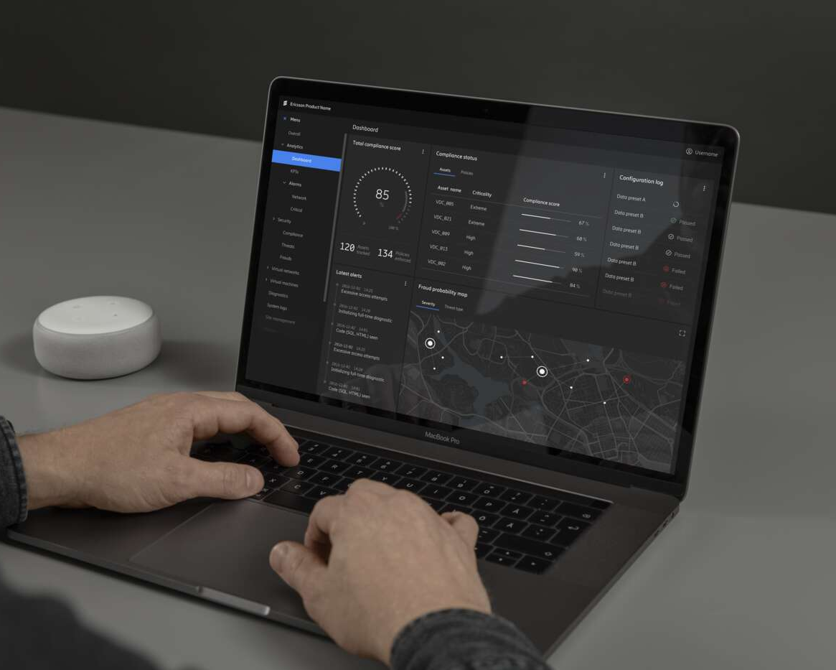
Summary: SD-WAN is an orchestration game
Managed services are the preferred model
SD-WAN is a multivendor ecosystem
Ericsson is building a complete solution
6/221 09-FGB 101 0800 Uen | B | SD-WAN is an orchestration game | | Commercial in Confidence | Page 25
Notes:
Summary – SD-WAN is an orchestration game
Slide responsible: Ana Freitas Best Before: April 2020
Initial waves
First wave: driven
by single vendor implementation of
SD-WAN devices
Second wave: driven by a service-centric approach in a
multi-vendor environment.
Managed services
Enterprises are opting for SD-WAN managed services due to high maintenance costs and lack of
in-house skills.
Selecting the
right service
Top criteria in selecting a managed service: network reliability, secure connectivity and flexible capacity in near real-time.
Flexibility without compromising quality
Service providers can manage multiple vendors, defining
paths to provide flexible bandwidth while assuring quality
of service.

Slide 26
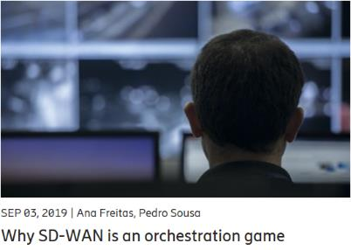
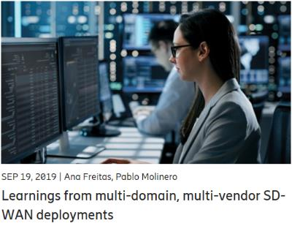
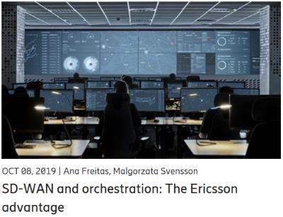
SD-WAN orchestration blogs
6/221 09-FGB 101 0800 Uen | B | SD-WAN is an orchestration game | | Commercial in Confidence | Page 26
Notes:
SD-WAN orchestration blogs
Slide responsible: Ana Freitas Best Before: April 2020

Slide 27
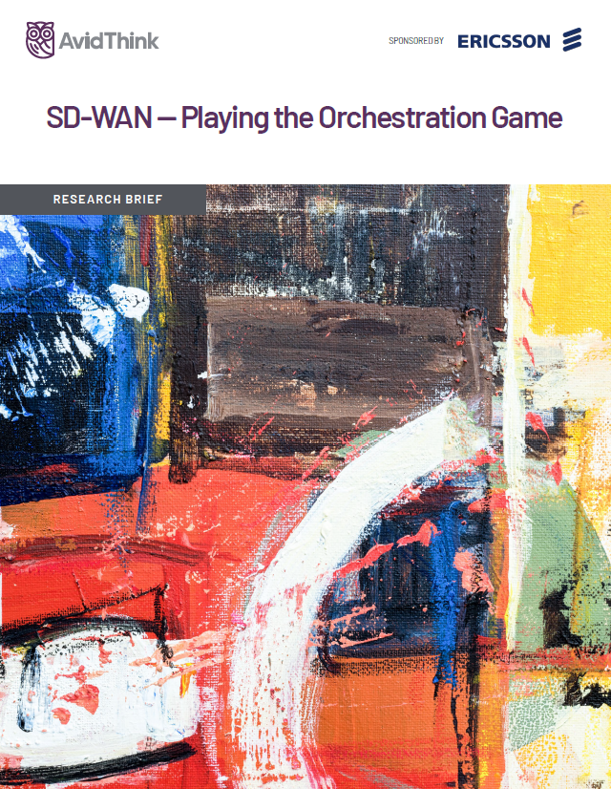
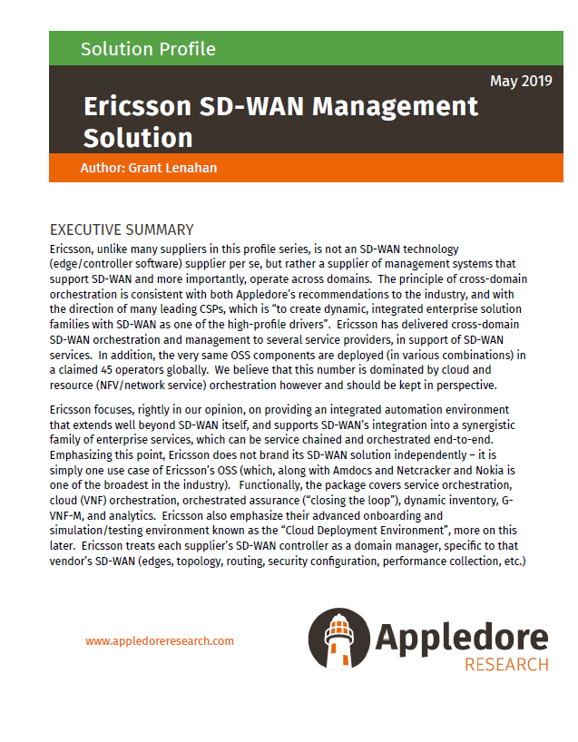
SD-WAN orchestration reports
6/221 09-FGB 101 0800 Uen | B | SD-WAN is an orchestration game | | Commercial in Confidence | Page 27
Notes:
SD-WAN orchestration reports
Slide responsible: Ana Freitas Best Before: April 2020

Slide 28
www.ericsson.com/dynamic-orchestration

